Slide 1
Descriptive Statistics with Minitab™
© McGraw Hill LLC. All rights reserved. No reproduction or distribution without the prior written consent of McGraw Hill LLC.

Slide 2
Copyright Notice Portions of Minitab statistical software input and output contained in this document are printed with permission of Minitab, Inc. MinitabTM is a trademark of Minitab Inc. in the United States and other countries and is used herein with the owner's permission.

Slide 3

Why Minitab?
Excel is useful for data manipulation and editing.
But Excel is not ideal for statistical analysis.
Minitab is easy to use, powerful, and affordable.*
Minitab has been used in education for decades.
* Educational pricing is available

Slide 4
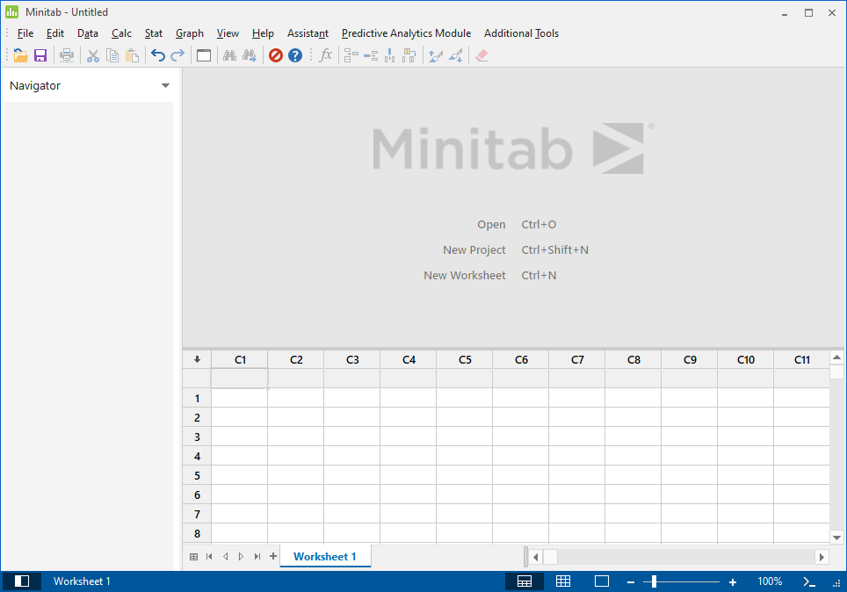
User Interface
Menu Bar (with drop-down menus)
Session Window (results will be displayed here)
Worksheet (like an Excel spreadsheet)

Slide 5
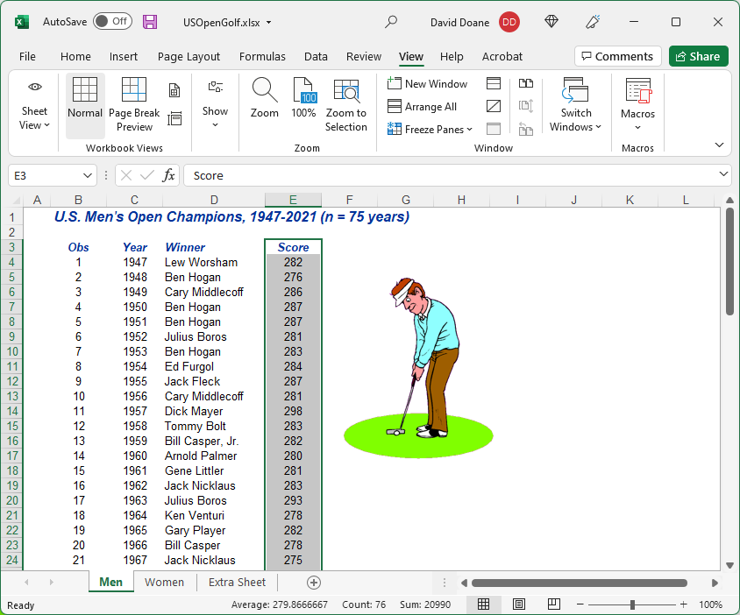
Copying Excel Data
Tip: To import data from Excel, highlight the data range, copy it (Ctrl-C), and paste (Ctrl-V) into a column of the Minitab worksheet.
Caution: If your Excel spreadsheet uses $ format or commas (e.g., $47,352) you should reformat to plain numbers (e.g., 47352) or Minitab may treat the data as text.

Slide 6
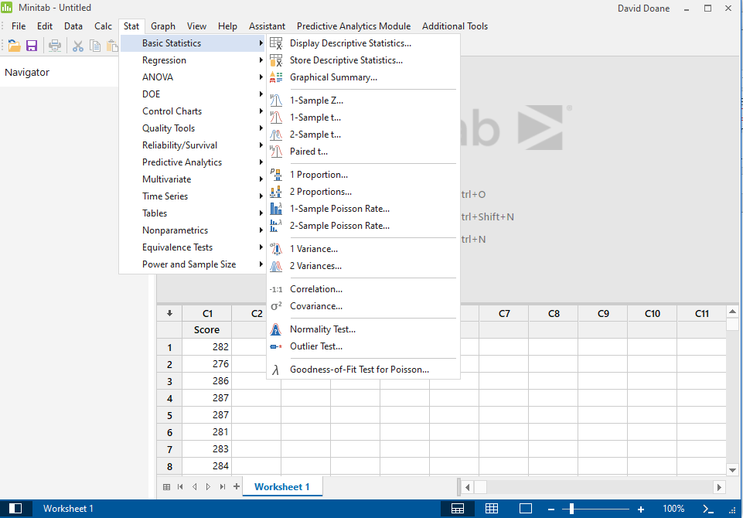
Basic Statistics
Tip: You will use this menu often. Statistical analysis usually begins with a look at descriptive statistics.
Tip: If you see the –T suffix (e.g., C2-T) in a column heading the data will be treated as text ( numerical data ).

Slide 7
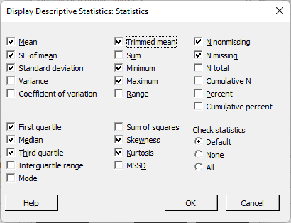
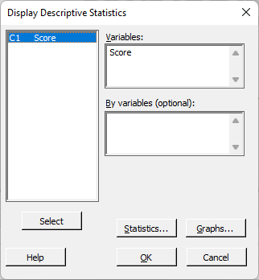
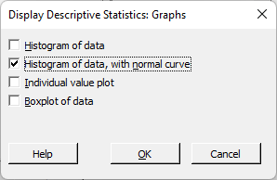
Descriptive Statistics
Tip: Text columns if any) will not be listed as variables because they are non-numerical.
Tip: Highlight the variable(s) you want and click Select.

Slide 8
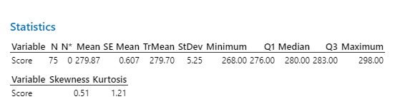
Descriptive Statistics
Tip: The session window shows your results. You can copy each result as text or as a PNG to paste it into Word or Excel.
Interpretation: The mean and median are almost the same for winning U.S. Open Golf scores for men (n = 75 years). However, the skewness and kurtosis statistics suggest possible asymmetry and leptokurtic distribution. Possible outlier(s)?

Slide 9
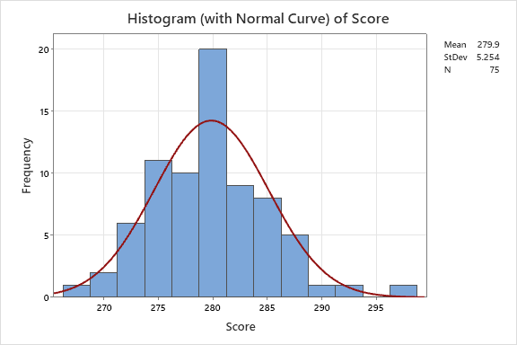
Descriptive Statistics
Tip: Each graph is in a separate window. Double click a graph to edit it. You can copy as a PNG to paste into Word or Excel.
Interpretation: The distribution appears somewhat bell-shaped except for a high concentration near 280 and an unusual value in the right tail.

Slide 10
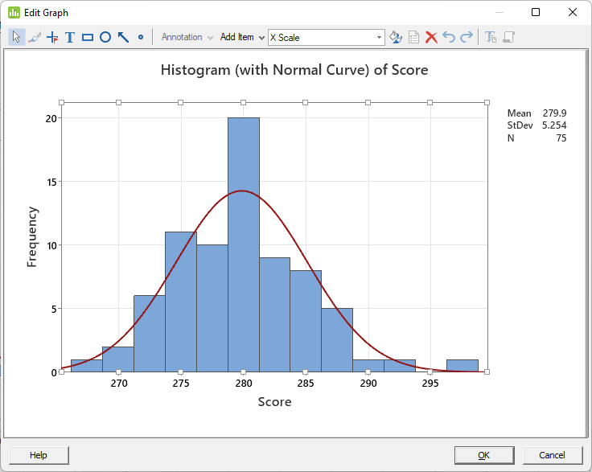
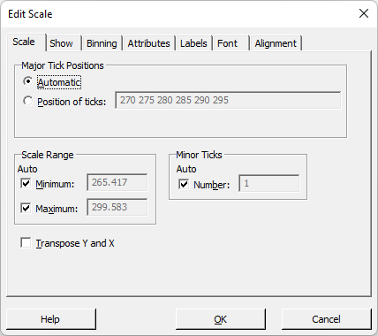
Editing Graphs
When you double-click on a graph feature (e.g., X-axis), edit tools will appear to edit text, fonts, colors, bins, etc.

Slide 11
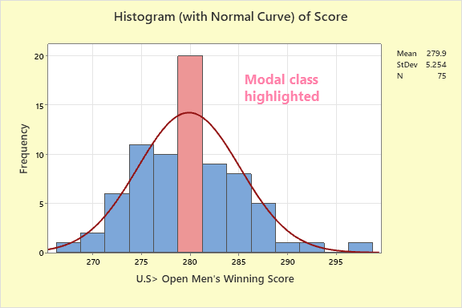

Graph Edits
Before
After
Comment: This example is merely to show what can be done, not to suggest that this is an improvement.

Slide 12
Copy a Graph
There are many choices for copying a graph.

Slide 13
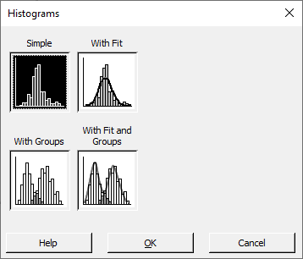
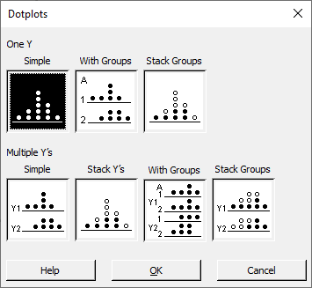
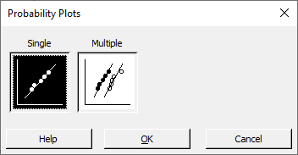
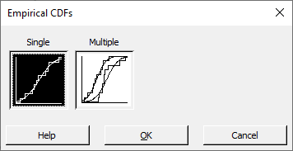
Graph Menus

Slide 14
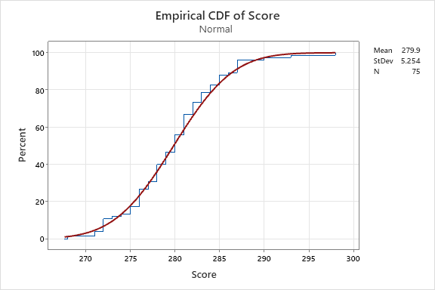
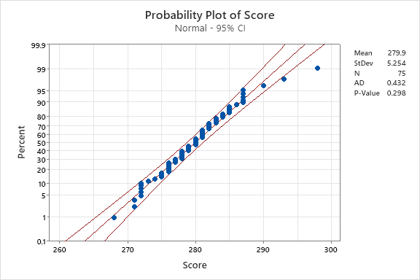
Examples
Interpretation: This empirical CDF resembles a normal curve. Its probability plot is linear except at the ends and overall is consistent with a normal (p = .290). Excel offers nothing like this.

Slide 15
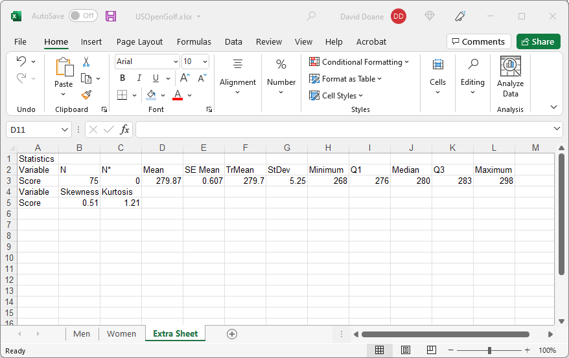
Paste Text In Excel
Tip: When you paste copied Minitab text into Excel, it might go into one column. If so, use Data > Text to Columns to align it into columns, using spaces as separators.

Slide 16
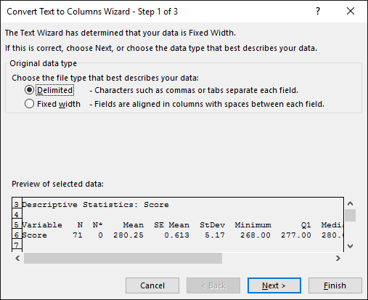
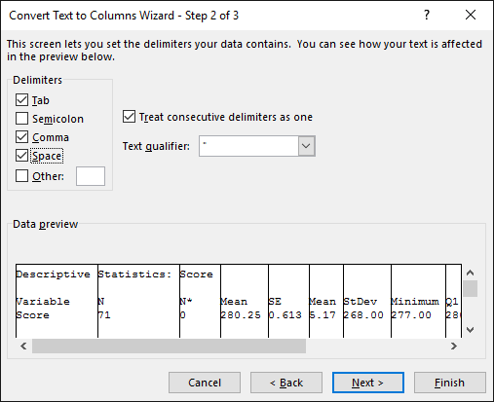
Text to Columns
Tip: Use Text to Columns to get text fields aligned into Excel columns, using the Delimited option with spaces and tabs as delimiters.

Slide 17
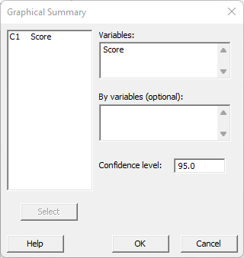
One-Click Stats
Minitab’s Graphical Summary gives nice graphs (histogram, box plot, confidence intervals) and key statistics (mean, standard deviation, min, max, quartiles, p-value for normality test, confidence intervals for mean, median, and standard deviation).
Tip: You may never need more than this!

Slide 18
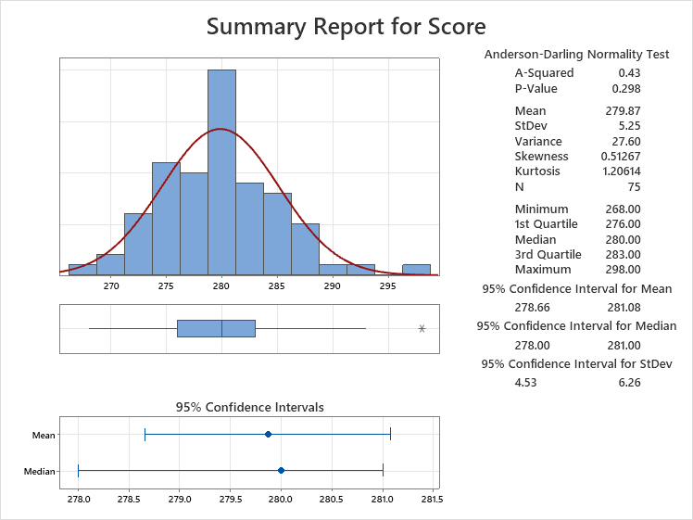
One-Click Stats
Minitab’s Graphical Summary gives nice graphs (histogram, box plot, confidence intervals) and key statistics (mean, standard deviation, min, max, quartiles, p-value for normality test, confidence intervals for mean, median, and standard deviation).
Tip: You may never need more than this!

Slide 19
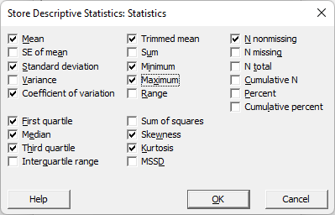
Storing Statistics
Tip: You can save desired statistics in the worksheet.

Slide 20
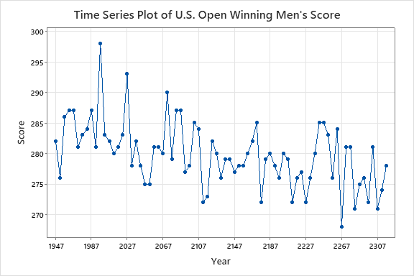
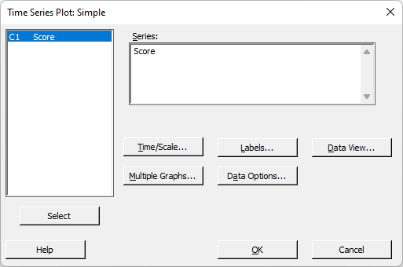
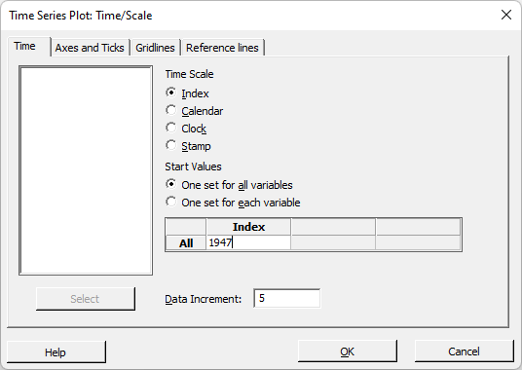
More Graphs
Note: Possible downward trend?
Tip: You can set the time scale labels and edit graph labels.

Slide 21
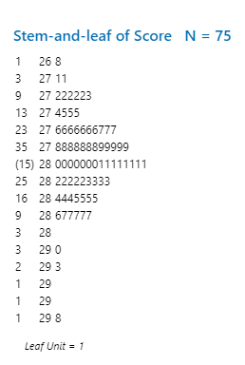
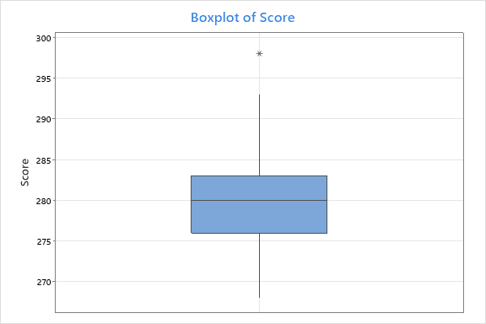
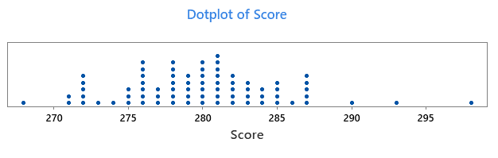
More Graphs

Slide 22
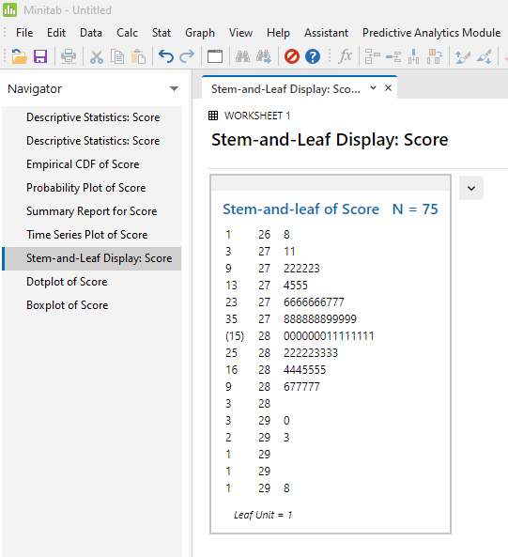
Where Did My Graphs Go?
Tip: Don’t panic. The Navigator pane shows all the graphs and results you have created.

Slide 23
Closing Tips
Minitab is an affordable complement to Excel.
Your university may already have a Minitab license.
Customize graphs before you copy them.
Use Paste Special to copy Minitab graphs to Word.

